Slide 1

BFX-AT100 System Hang-up
Failure Analysis Report
Prepared by PE: Thuc
2023/03/07

Slide 2
D1
Establish the Team
Team Leader
Team Member
PE: Michael, Thuc
ME: Cheng Lun, Hugo
PM: An Tran, Yuri
PD: Wen Yong
QA: Toney, Ken,
TE: Mark, Jones
IE: Hai Ly, Heng Ruan
Foxconn
  MFG Director: David Yin
  QA Manager : CB Lin, Toney

Slide 3
D2
Problems description
Issue Description ( 5W2H)
When | 2023/03/01
Who | ALT customer
Where | SK networks warehouse, Anseong, Korea.
What | ALT customer feedback that they found out 1pcs system hang-up
Why | U1-SoC material issue , P/N: 002.02753.005
How | System hang-up
How many | Total 1pcs as below table.
No | Description Issue | S/N | MAC
1 | System hang-up | 2149688001202099000013 | D81265923DBB

Slide 4
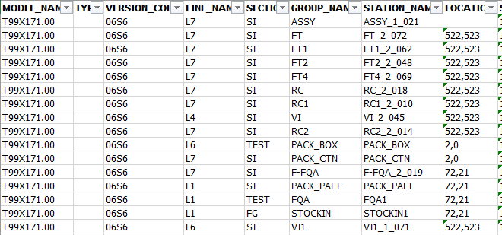
D3
Containment
1. Recheck production data record.
2. Recheck test log
No# | Station | Status
1 | UK | PASS
2 | FT | PASS
3 | FT1 | PASS
4 | RC | PASS
5 | RC1 | PASS
6 | RC2 | PASS
Summary:
- Recheck production data record and test log ➔ Did not find out any abnormal.

Slide 5

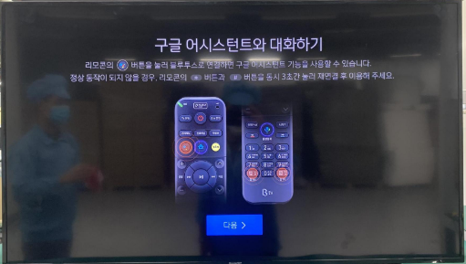
D4
Root Cause: Retest OBA function
1. Retest NG sample at OBA station:
NG board
OK board
Summary: Retest at OBA station ➔ NG board can’t boot up and no console log.

Slide 6
D4
Root Cause: Retest FATP
2. Retest NG sample at FATP, the result as below:
No# | Station | Status | Remark
1 | UK | Fail | NG board can’t boot up ➔can’t retest FATP
2 | FT | Fail
3 | FT1 | Fail
4 | RC | Fail
5 | RC1 | Fail
6 | RC2 | Fail
Summary:
- Retest NG sample at FATP ➔ NG board can’t boot up.

Slide 7
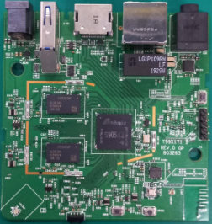
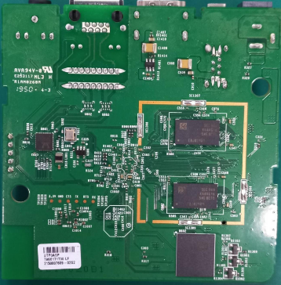
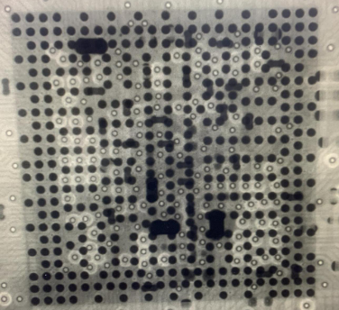
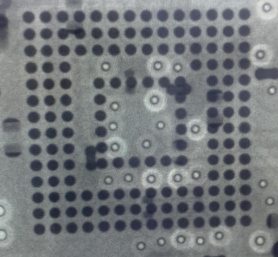
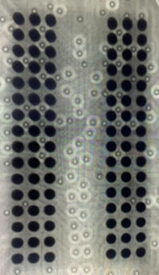
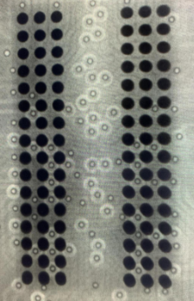
D4
Root Cause: Visual Inspection and Take X-ray
3. Check Visual inspection and take X-ray NG sample, result as below:
Item | Top side | Bottom side | Result
Visual inspection |  |  | No abnormality
Item | SoC | eMMC | RAM | Result
X-ray |  |  |  | No abnormality
Summary:
- Check visual inspection and take X-ray ➔ Result: No abnormality

Slide 8
D4
Root Cause: Impedance/VF Measurement
4. Measure impedance & Voltage on board of NG sample and compare with OK sample, result as table below:
Impedance & voltage power measurement on board
No. | Location | Description | NG sample |  | OK sample
 |  |  | Impedance (Ω) | Voltage power (V) | Impedance (Ω) | Voltage power (V)
1 | L306 | DC_5V | 1.9M | 5.2 | 1.98M | 5.2
2 | L303 | P1V2 | 173.9 | 1.2 | 183 | 1.2
3 | R325 | P2V5 | 16.97K | 2.5 | 17.74K | 2.49
4 | L304 | P3V3 | 3.09K | 3.3 | 2.8K | 3.3
5 | R607 | eMMC_VDDF | 3.09K | 3.3 | 2.8K | 3.3
6 | L301 | VDDCPU | 74.8 | 0.88 | 74 | 0.87
7 | L302 | VDD_EE | 35 | 0.83 | 36.6 | 0.83
8 | R324 | P1V8 | 59 | 1.79 | 2.6K | 1.8
Summary: Impedance/ voltage power measurement ➔ Found impedance abnormal at R324 location (P1V8)

Slide 9
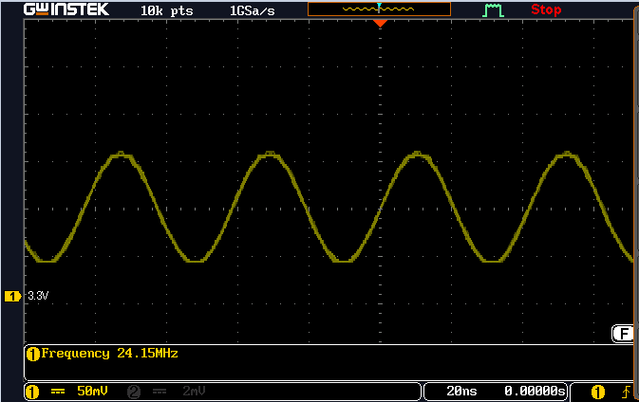
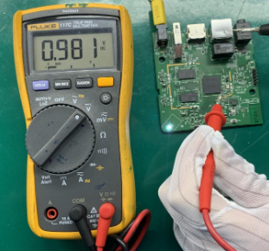
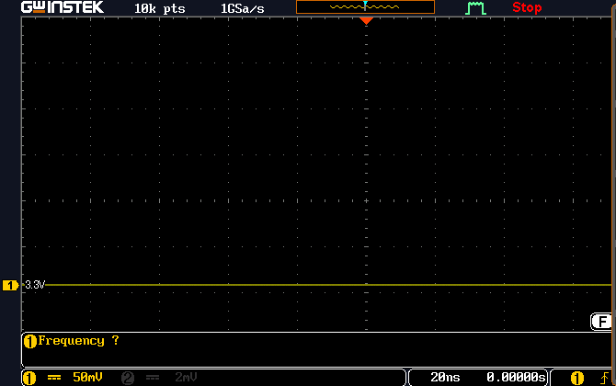
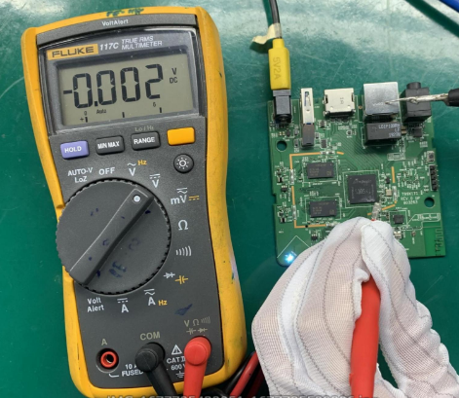
D4
Root Cause: Crystal Signal Measurement
5. Use oscilloscope/ multi meter to measure crystal signal at Y401 location:
OK board
Frequency=24.15MHz
NG board
Frequency = 0 Hz
Summary: NG board hasn’t crystal signal at Y401 location and didn’t voltage supply

Slide 10
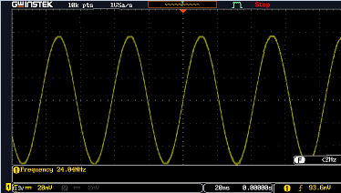
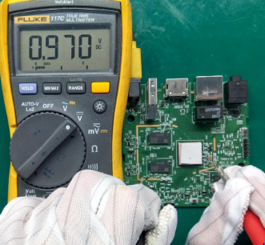
D4
Root Cause: Change Component
6. Change new component :
- Baking at 45 degree within 24 hours ➔ Retest OBA: NG board can’t boot up
- Change new Y401 then measure voltage at Y401 location ➔Result: Fail (No voltage and crystal signal)
- Re-solder SoC at 180 degree within 3 minutes ➔ Result: No voltage at Y401 location.
- Re-solder SoC at 410 degree within 25 second ➔Result: No voltage at Y401 location.
- Change new SoC and measure crystal signal➔ Result: Pass (NG board boot up normally)
NG board after change new SoC
Frequency = 24.04 MHz
Summary: After Change new SoC and measure crystal signal➔ Result: Pass (NG board boot up normally)

Slide 11


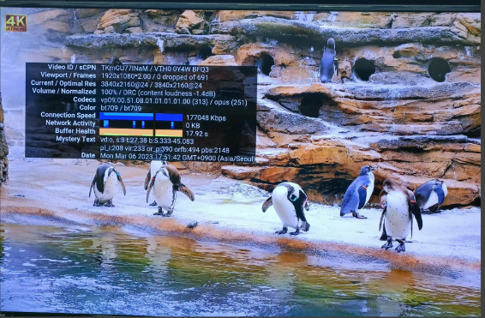

D4
Root Cause: Retest FATP
7. Retest FATP:
- Burning 2hours/50 degree in burning chamber after retest FATP and test OBA function 5 times :
No. | Test station | Log test | Result
1 | FT |  | Pass
2 | FT1 |  | Pass
3 | RC |  | Pass
4 | RC1 | N/A | Pass
5 | RC2 | N/A | Pass
Items | 1 | 2 | 3 | 4 | 5 | Result
OBA function | Pass | Pass | Pass | Pass | Pass | Pass
Watch video 4K on Youtube
Summary: Retest FATP and OBA function ➔ Pass normally

Slide 12
D4
Root Cause: Impedance Measurement NG SoC
8. Measure impedance and voltage diode on pin of component focus on crystal block:
No. | PIN | Description | OK sample |  | NG sample
 |  |  | Impedance ( Ohm ) | Voltage diode ( VF ) | Impedance ( Ohm ) | Voltage diode ( VF )
1 | AL41 | SYS_OSCIN | 11.64M | 0.8 | 11.65M | 0.8
2 | AN43 | SYS_OSOUT | 11.39M | 0.79 | 11.41M | 0.79
3 | AJ39 | AVDD18_AO_3 | 0.85M | 0.5 | 105 | 0.08
4 | AL43 | SARADC_CH1 | 3.5M | 0.79 | 5.41M | 0.78
5 | AJ31 | VDD_EE | 1.77K | 0.244 | 1.8K | 0.257
6 | AJ23 | VDDCPU | 77 | 0.08 | 75.3 | 0.08
7 | G29 | VDDIO_AO | 3.3M | 0.6 | 3.3M | 0.6
8 | BA25 | TEST_N | 3.04M | 0.79 | 3.18M | 0.78
9 | AJ37 | RESET_N | 3.04M | 0.79 | 3.1M | 0.78
Summary: Measure impedance & voltage diode ➔ Find out abnormal at Pin AJ39: AVDD18AO_3

Slide 13
D4
Root Cause: Swap Verification SoC
9. Reball and do a swap verification U1_SoC:
Check boot up | 1 | 2 | 3 | 4 | 5
OK board + OK SoC | OK | OK | OK | OK | OK
NG board + NG SoC | NG | NG | NG | NG | NG
OK board + NG SoC | NG | NG | NG | NG | NG
NG broad + OK SoC | OK | OK | OK | OK | OK
Summary: As analyzed above this issue follow U1-SoC ( P/N: 002.2753.005 ) component

Slide 14
D4
Root Cause: Summary
Root Cause Summary
System hang-up caused by U1-SoC material issue.
P/N: 002.02753.005
Vendor: AMLOGIC

